Slide 1

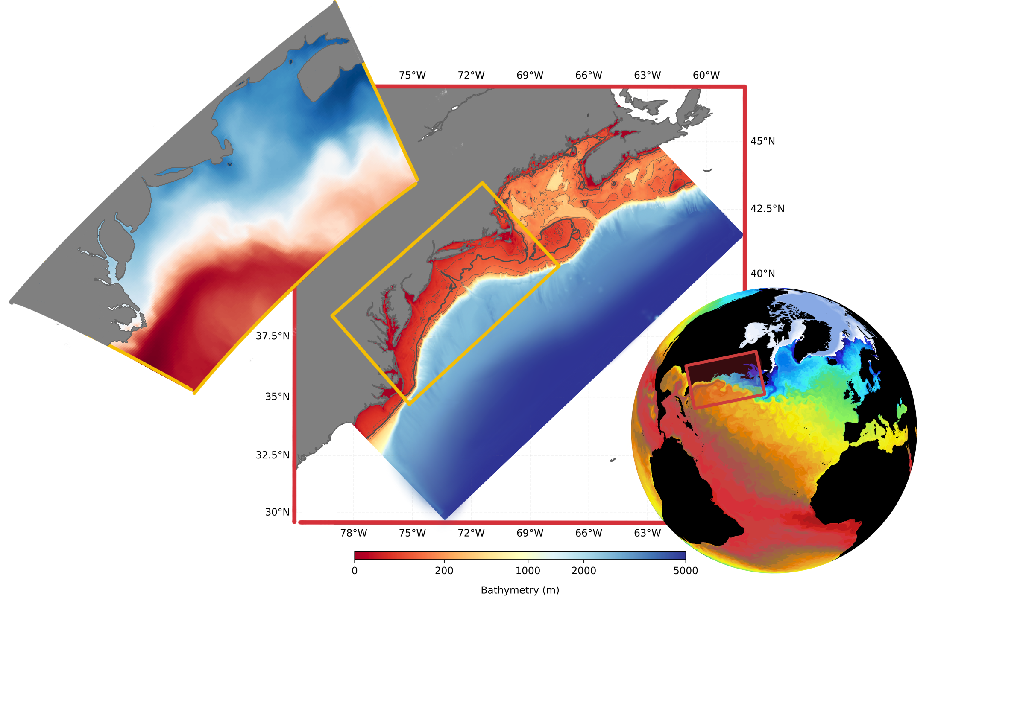
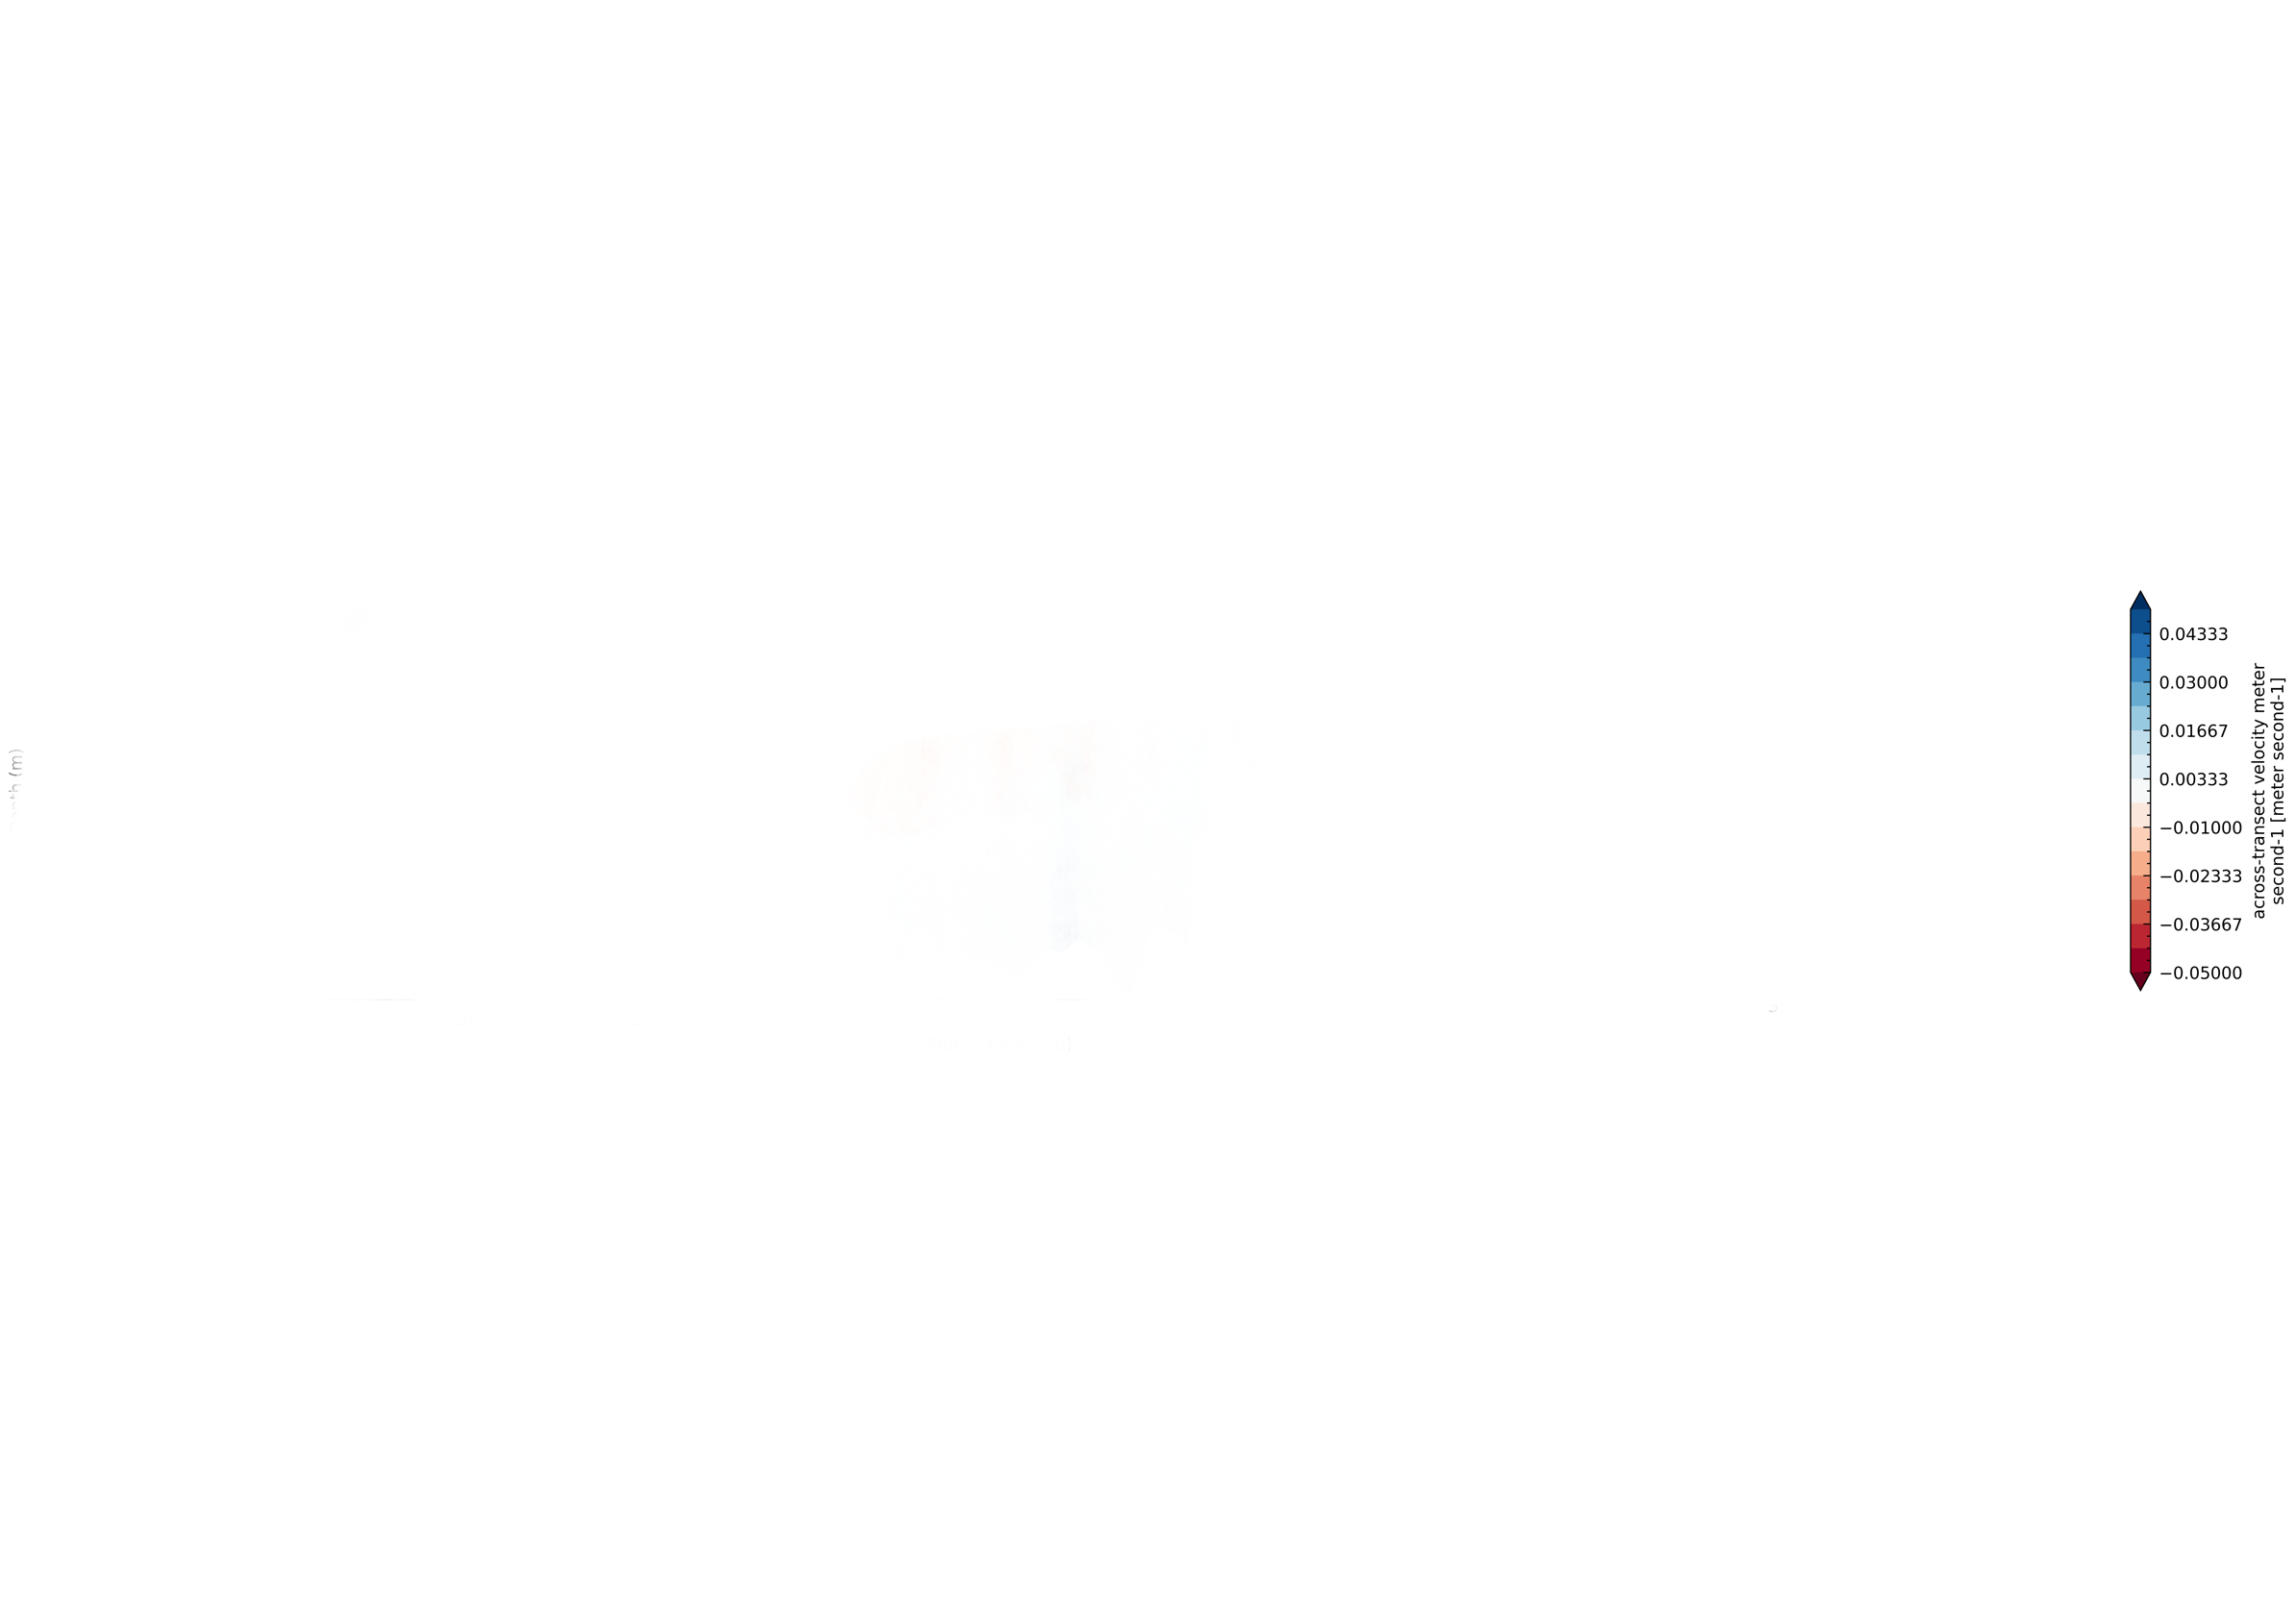
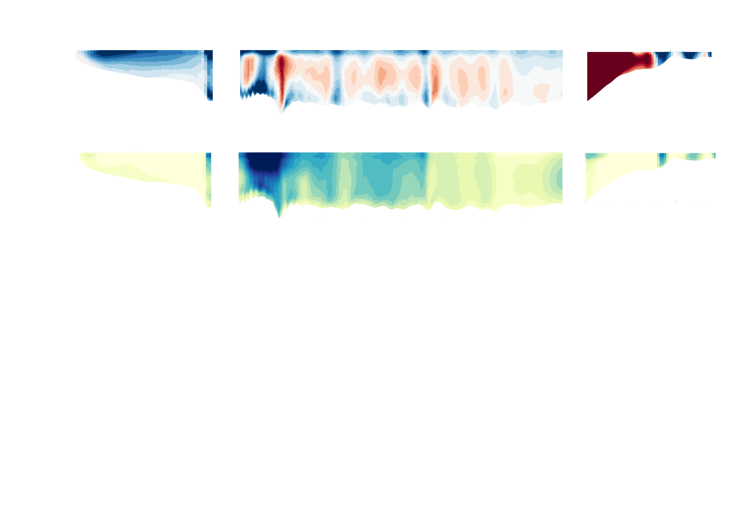

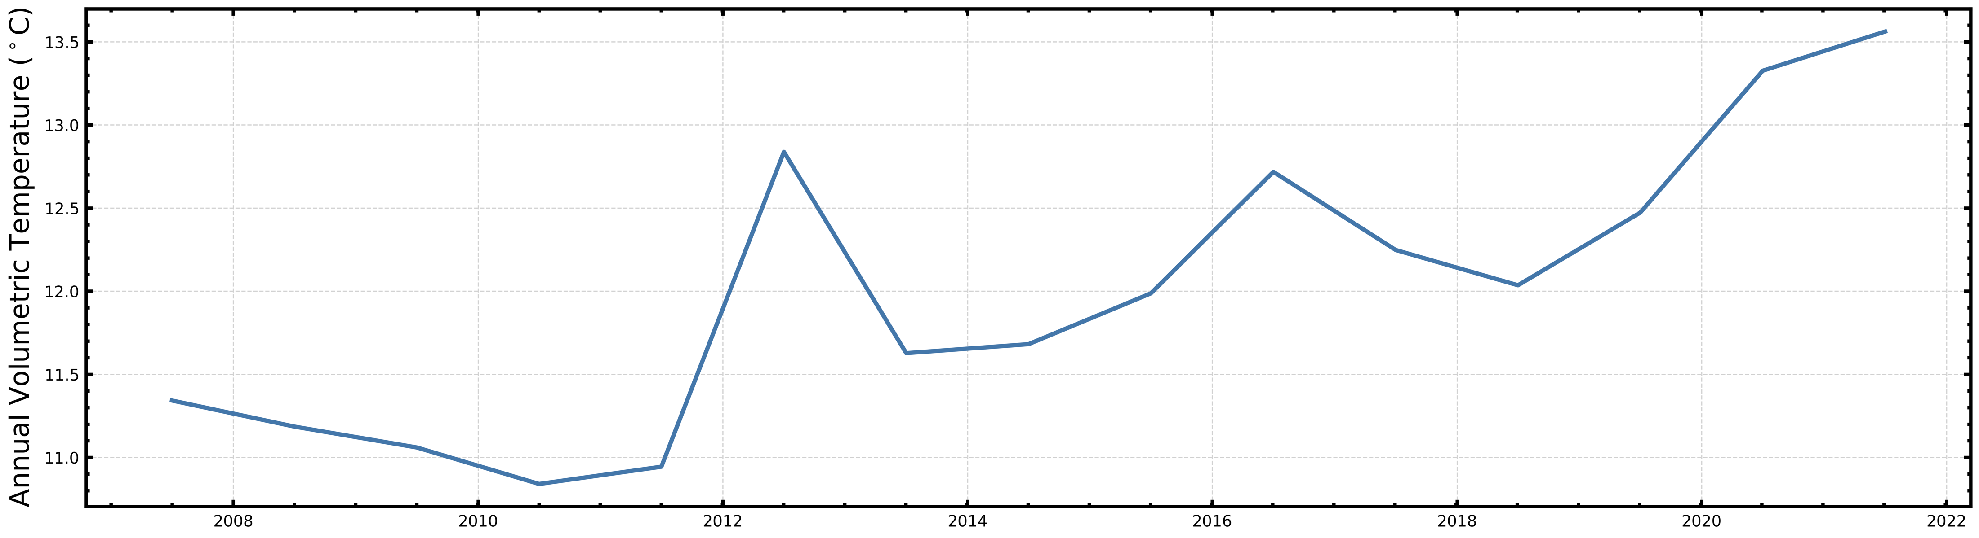

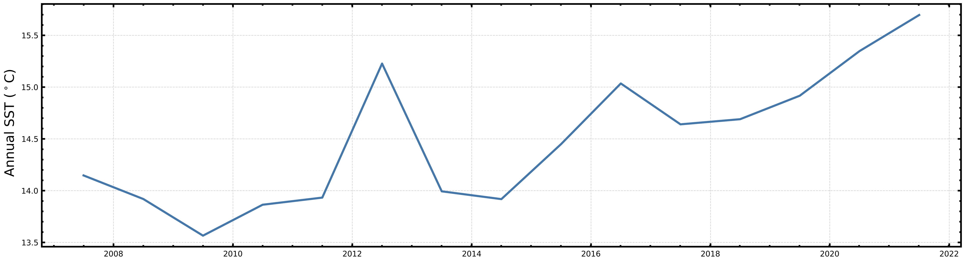
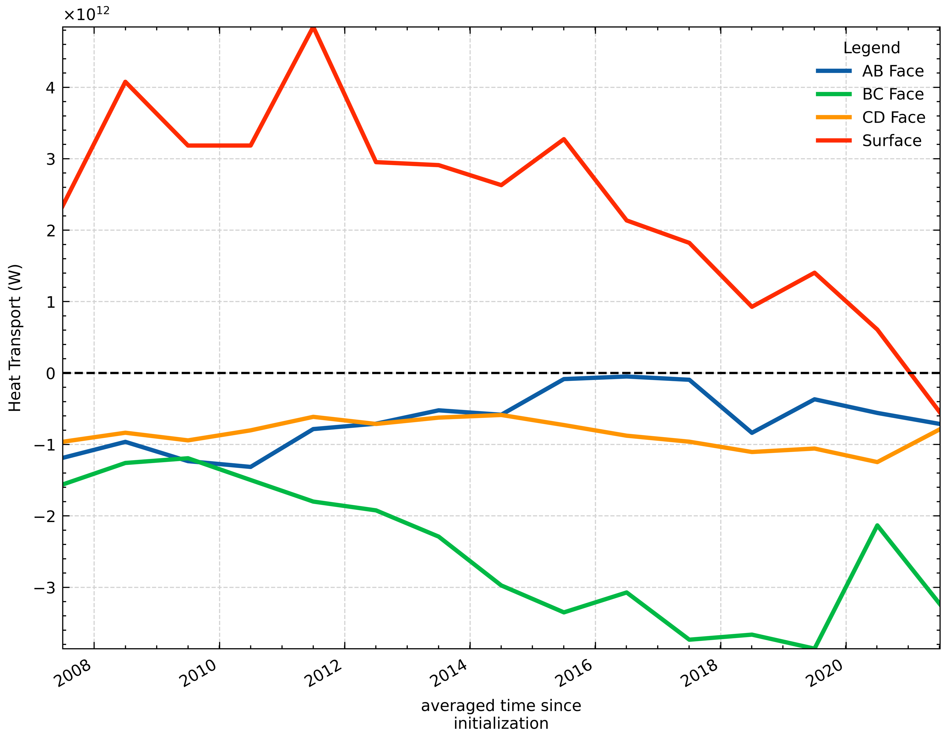
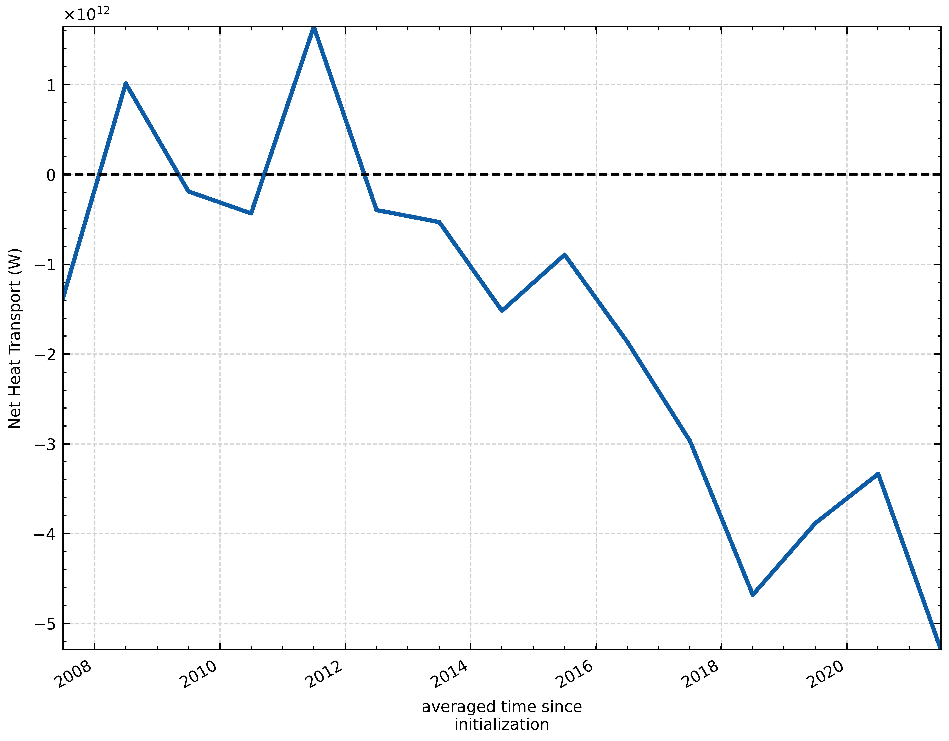
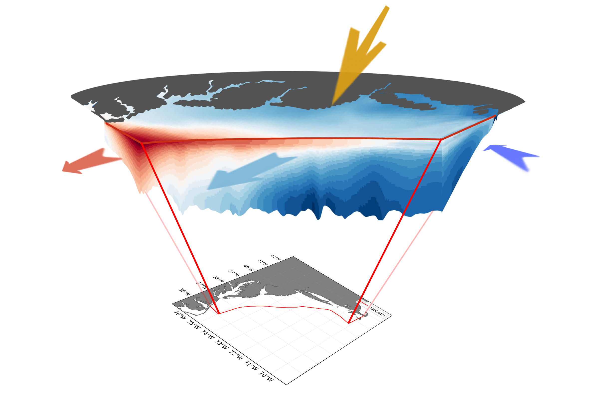

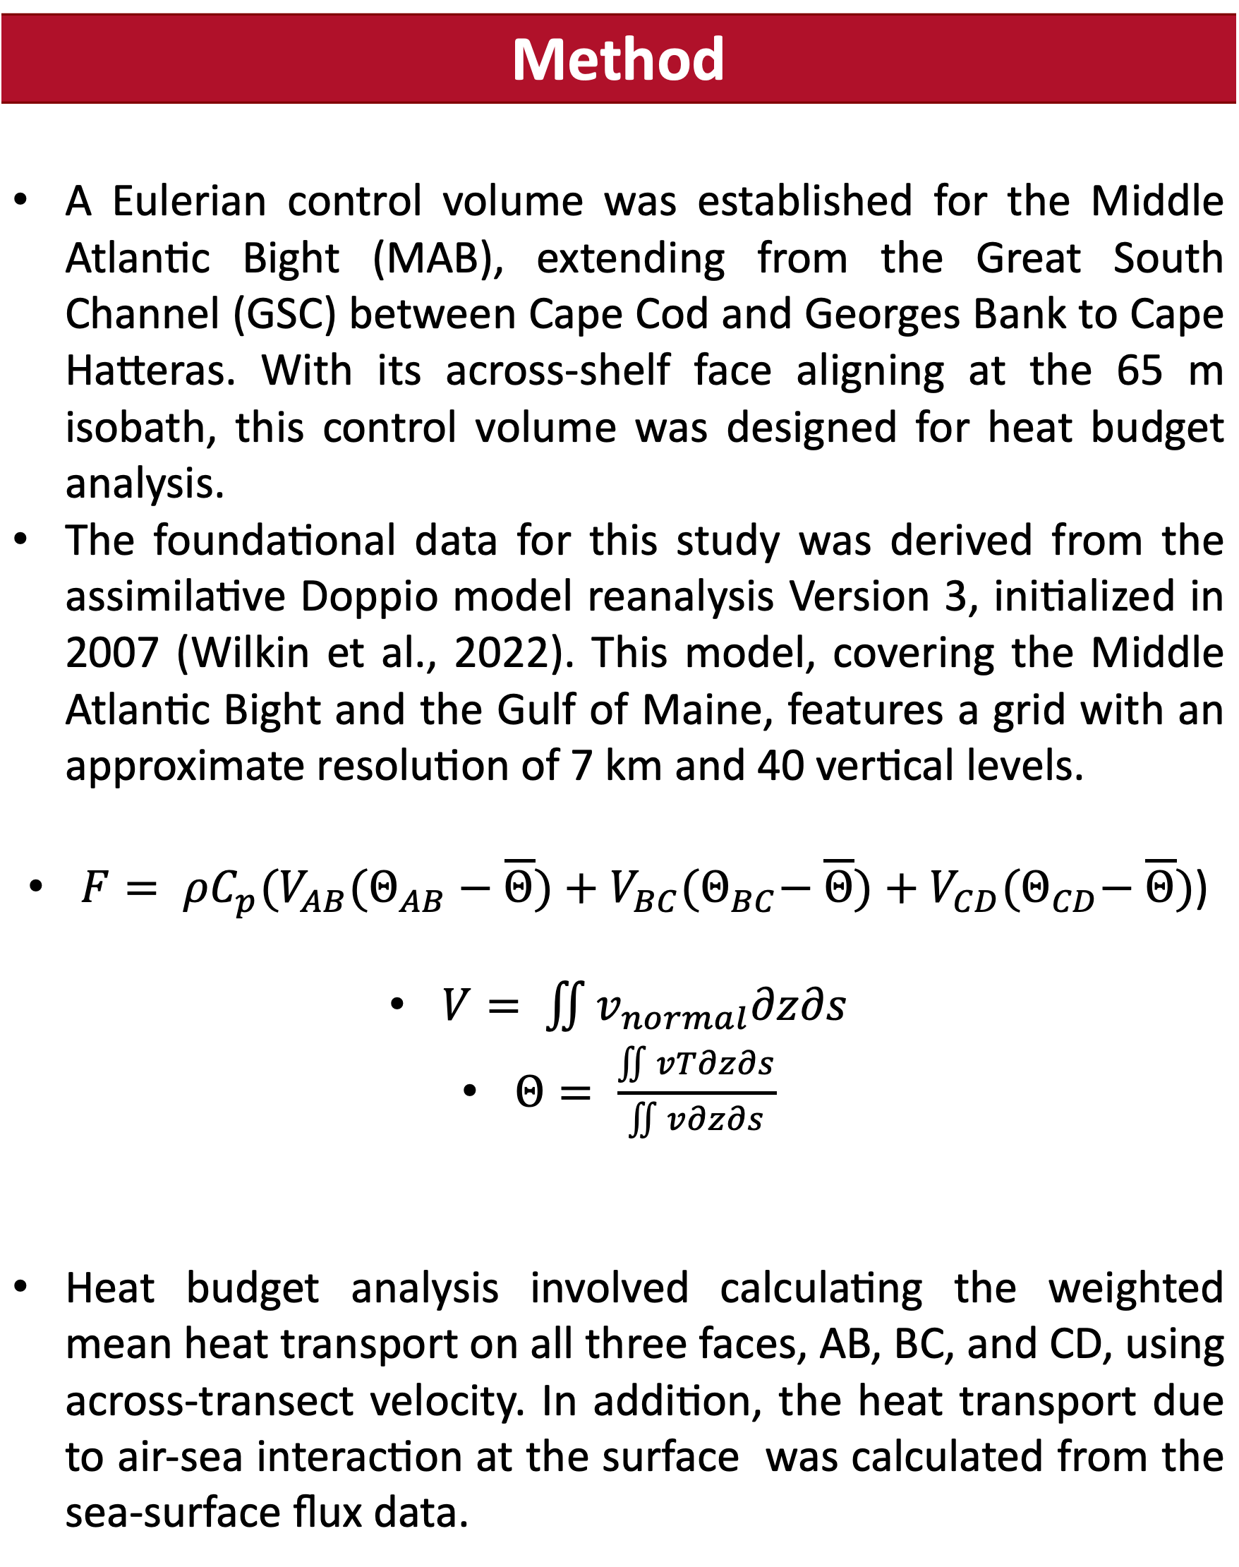
Heat Flux Mechanisms in the Mid-Atlantic Bight: Air-Sea Flux vs. Circulation Induced Flux
Suman Shekhar (ss4338@marine.Rutgers.edu), John Wilkin
Motivation
What does the flow look like?
Along-transect snapshot of normal velocity and parallel velocity.
Mid Atlantic Bight (MAB) undergoes significant warming as cool water pools journey from Cape Cod to Cape Hatteras.
What is the physical mechanism behind the increase warming trend of MAB – Air-Sea flux contribution Vs Circulation induced flux contribution?
A
B
C
D
Across-Transect velocity
Along-Transect Velocity
Results
Warming due to Internal variability rather than slow annual heating due to circulation or surface warming as speculated.
Method
A Eulerian control volume was established for the Middle Atlantic Bight (MAB), extending from the Great South Channel (GSC) between Cape Cod and Georges Bank to Cape Hatteras. With its across-shelf face aligning at the 65 m isobath, this control volume was designed for heat budget analysis. The foundational data for this study was derived from the assimilative Doppio model reanalysis Version 3, initialized in 2007 (Wilkin et al., 2022). This model, covering the Middle Atlantic Bight and the Gulf of Maine, features a grid with an approximate resolution of 7 km and 40 vertical levels. $F= ρC_{p}(V_{AB}{(Θ}_{AB} − \overline{Θ})+V_{BC}{(Θ}_{BC}− \overline{Θ})+V_{CD}{(Θ}_{CD}− \overline{Θ})$) $V= \iint{v_{normal}∂z∂s}$ $Θ= \frac{\iint{vT∂z∂s}}{\iint{v∂z∂s}}$ Heat budget analysis involved calculating the weighted mean heat transport on all three faces, AB, BC, and CD, using across-transect velocity. In addition, the heat transport due to air-sea interaction at the surface was calculated from the sea-surface flux data.
Textbook interpretation of warming based on heat flux balance
A
D
Future Directions and Questions
The role of eddy variability is a key element not yet fully accounted for in this study. The dynamics of heat transfer are influenced by eddies beyond the interaction of annual mean velocity and annual mean temperature, suggesting more complex physical interplay. Future investigations will explore the influence of eddy variability on the observed heat imbalance and investigate the intricate physical phenomena driving the heat dynamics within the MAB.
B
C
References
Wilkin et al., (2022), Progress in Oceanography, 209, 102919.

